Slide 1
Scikit-Learn
Nguyen Van Thieu

Slide 2

Python Libraries for Data Science
NumPy:
introduces objects for multidimensional arrays and matrices, as well as functions that allow to easily perform advanced mathematical and statistical operations on those objects
provides vectorization of mathematical operations on arrays and matrices which significantly improves the performance
many other python libraries are built on NumPy
Link: http://www.numpy.org/

Slide 3

Python Libraries for Data Science
SciPy: (Scientific Python)
collection of algorithms for linear algebra, differential equations, numerical integration, optimization, statistics and more
part of SciPy Stack
built on NumPy
Link: https://www.scipy.org/scipylib/

Slide 4

Python Libraries for Data Science
SciKit-Learn
Extensions to SciPy, called SciKits (Short form: sklearn)
provides machine learning algorithms: classification, regression, clustering, model validation etc.
built on NumPy, SciPy and matplotlib
Sits on top of C libraries: LAPACK, LibSVM, and Cython
Open source: BSD License (part of Linux)
Best general ML framework
Link: http://scikit-learn.org/

Slide 5
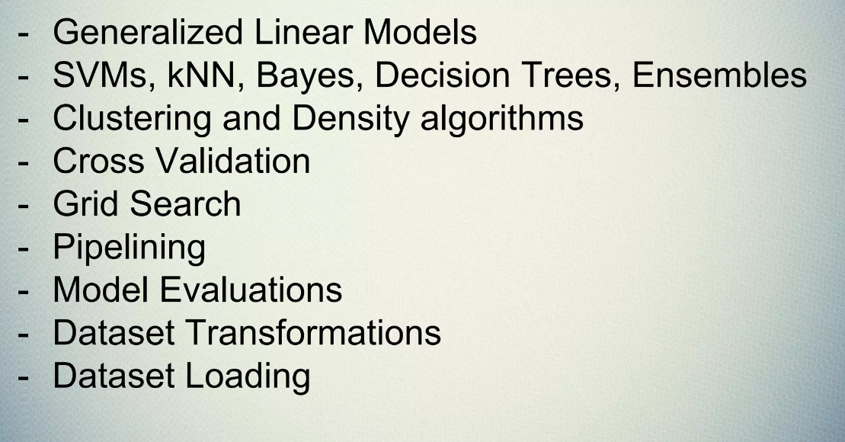
Primary Features

Slide 6
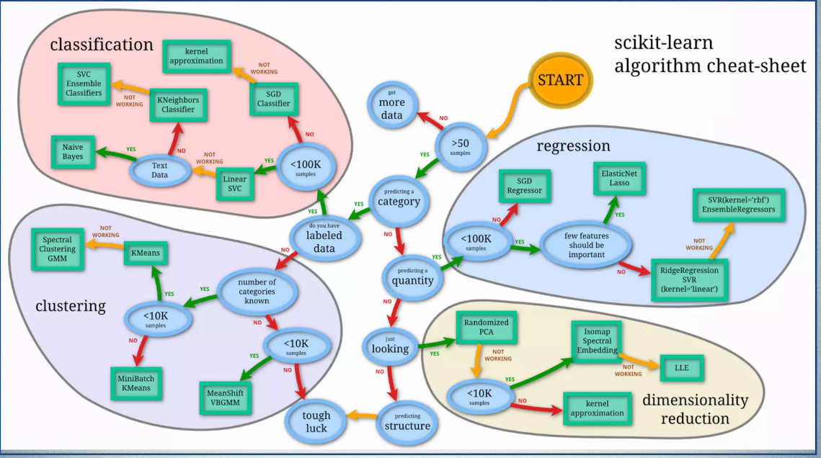
Scikit-Learn CheatSheet

Slide 7
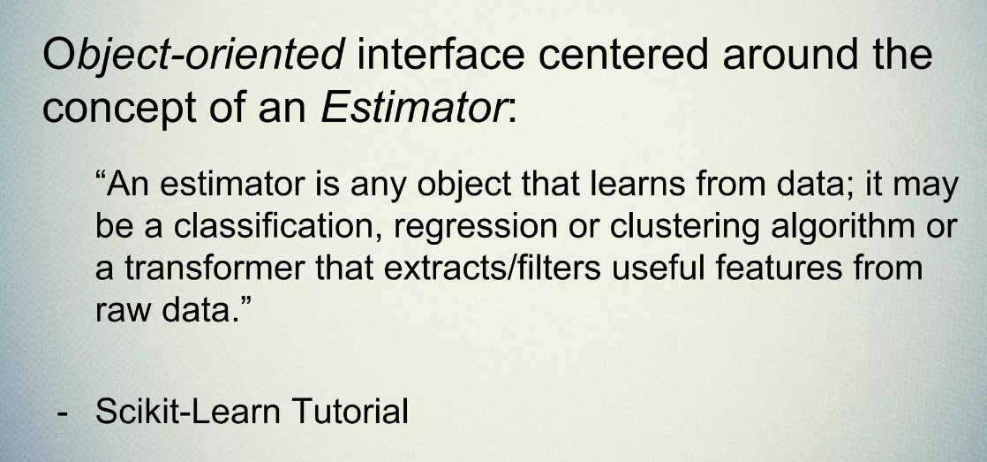
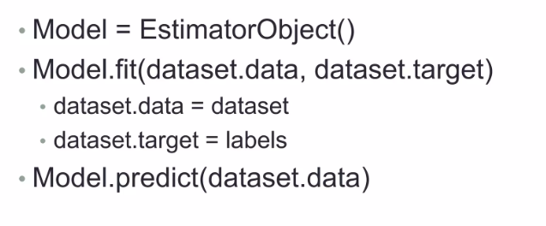
Scikit-Learn API

Slide 8
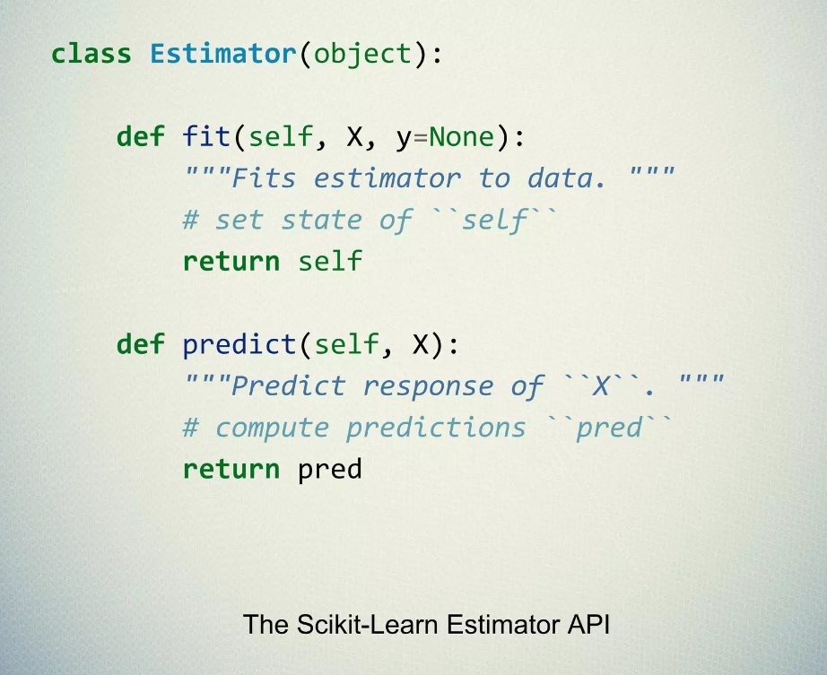
Estimators

Slide 9
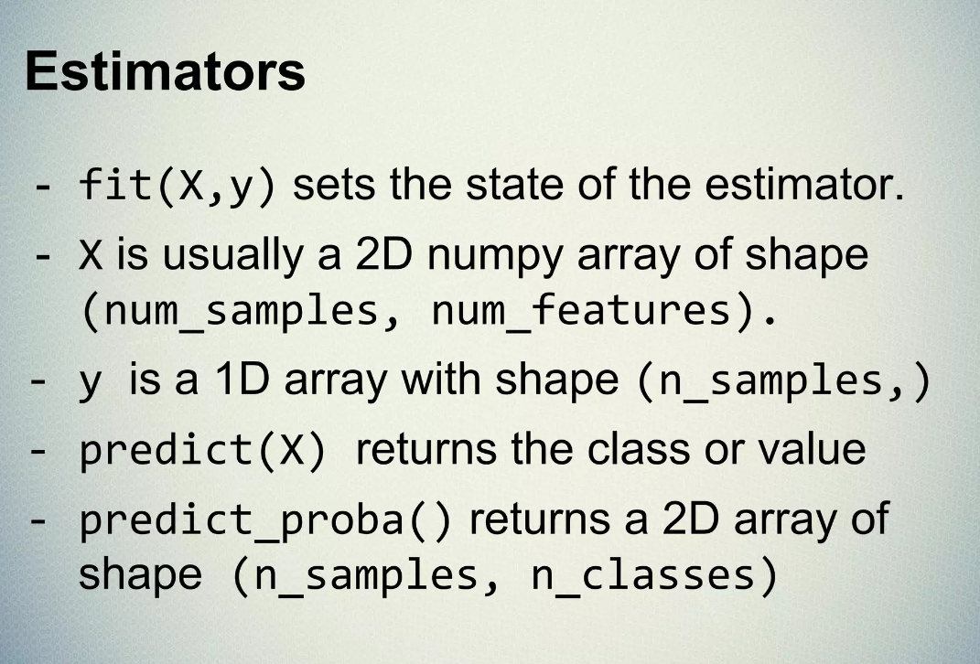
Estimator Example

Slide 10
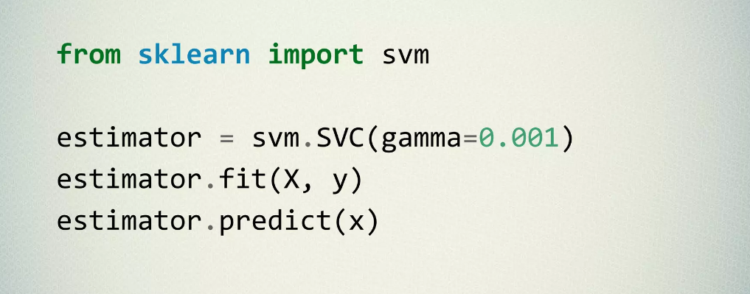
SVM Estimator

Slide 11
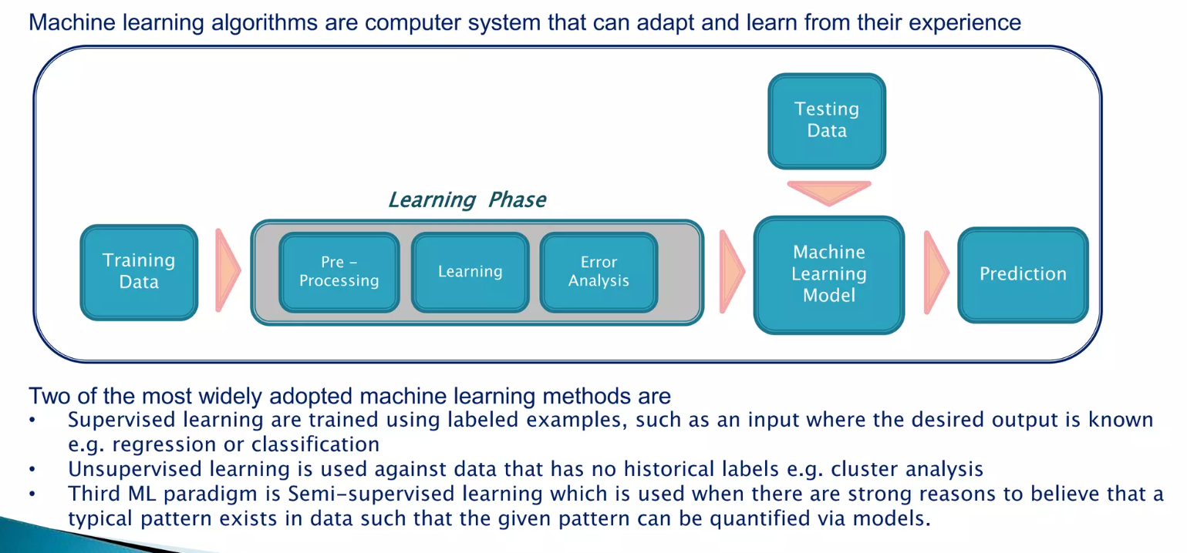
ML workflow

Slide 12
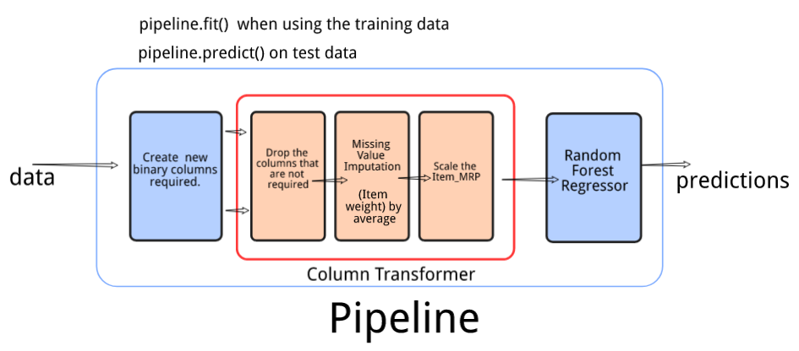
Pipeline

Slide 13
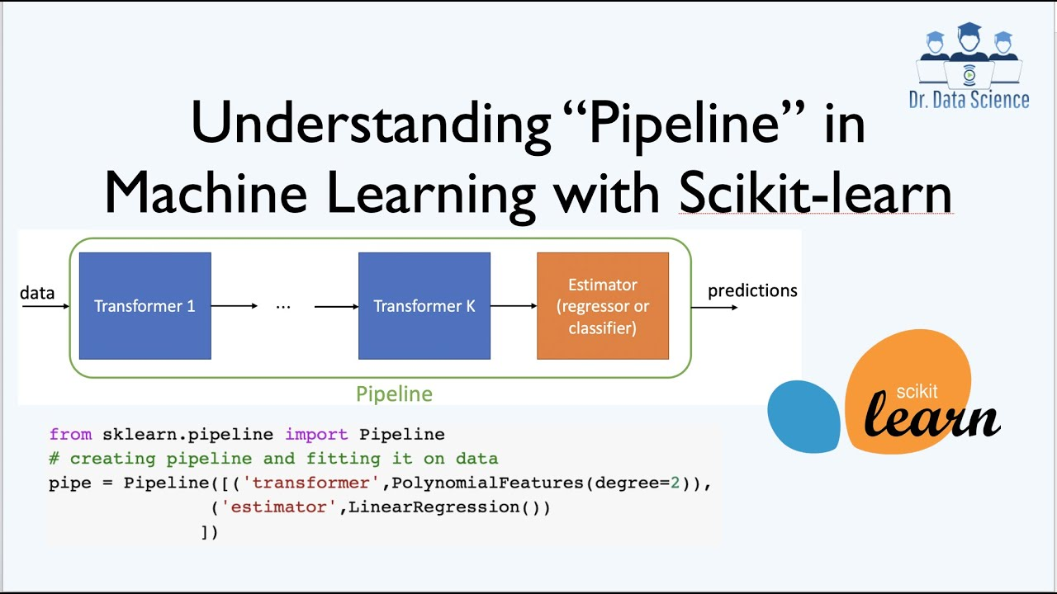
Pipeline

Slide 14
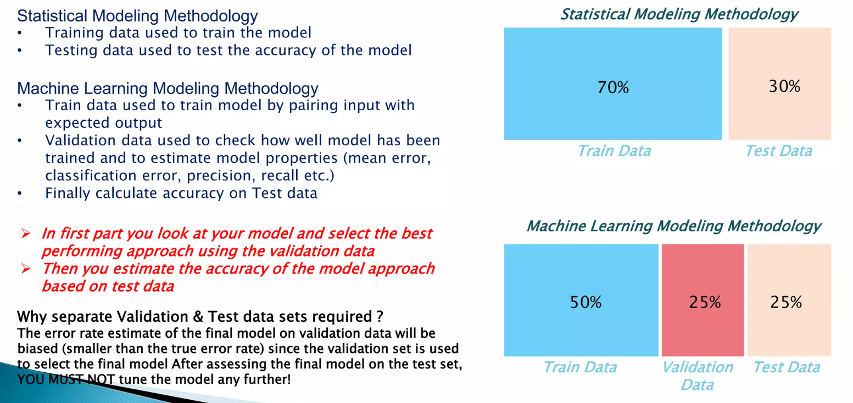
Training Validation & Testing

Slide 15
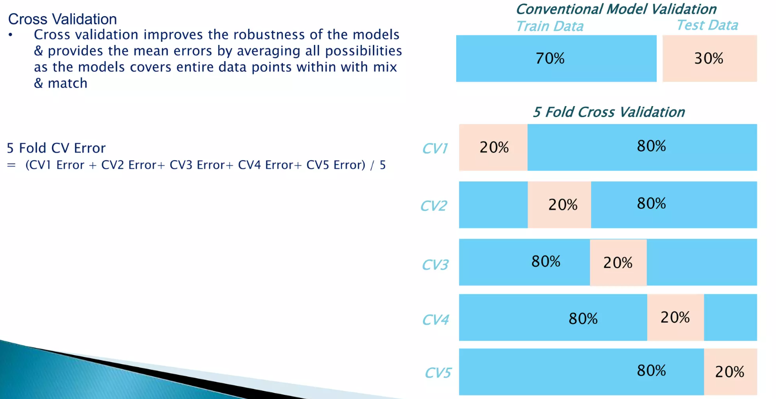
Cross Validation

Slide 16
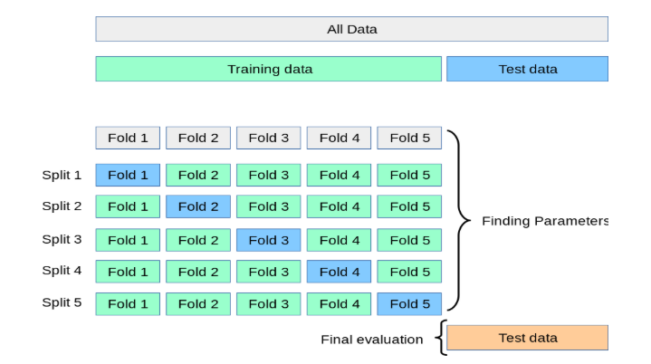
Cross Validation

Slide 17
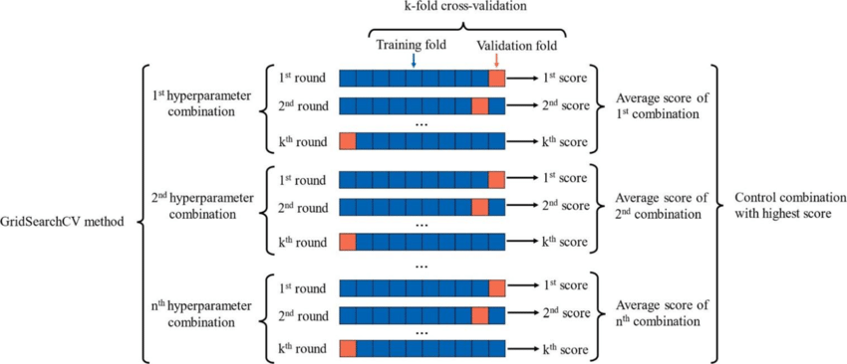
GridSearchCV

Slide 18
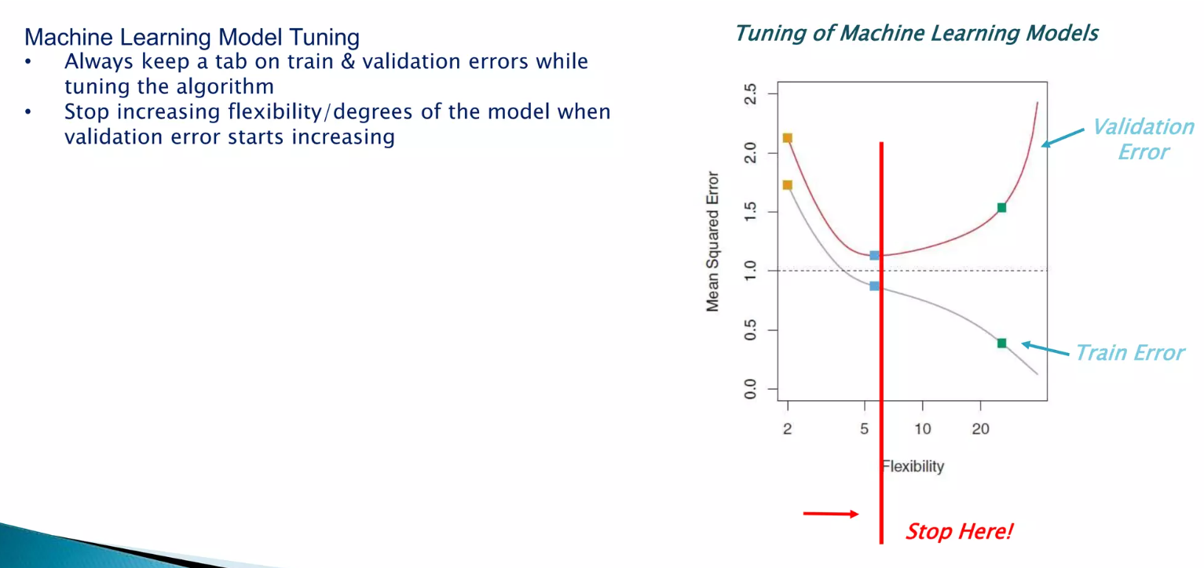
When to Stop Training Model

Slide 19
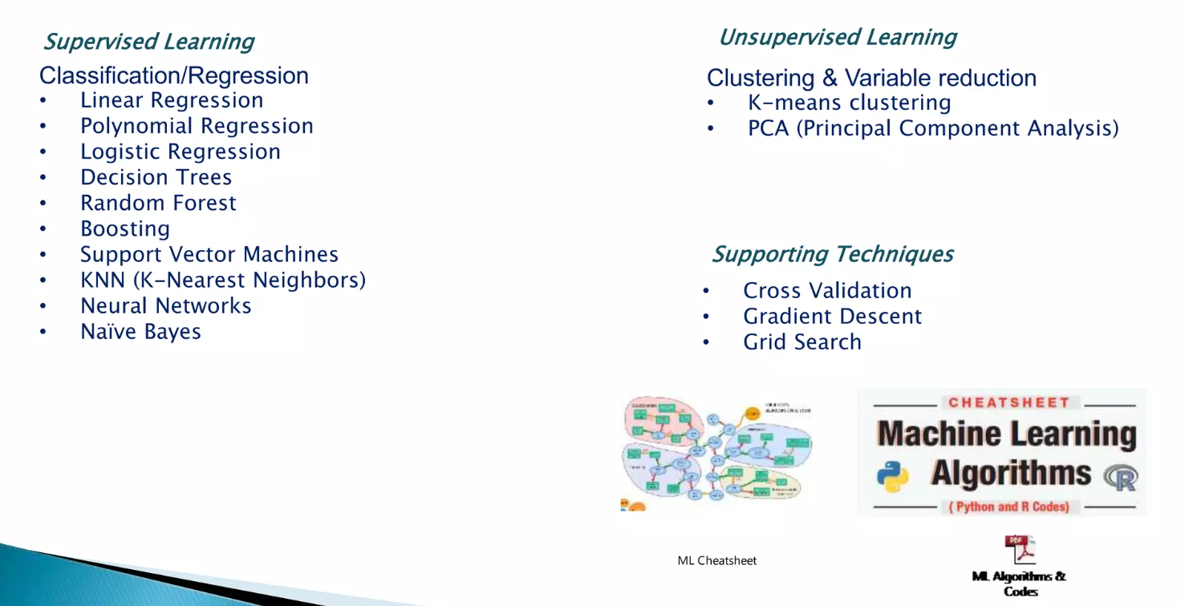
ML Algorithms in Scikit-Learn

Slide 20
Referecens
1. https://www.slideshare.net/PratapDangeti/machine-learning-with-scikitlearn-72720571
2. https://www.slideshare.net/SarahGuido/a-beginners-guide-to-machine-learning-with-scikitlearn
3. https://slideplayer.com/slide/15760442/
4. https://www.slideshare.net/BenjaminBengfort/introduction-to-machine-learning-with-scikitlearn

